Slide 1
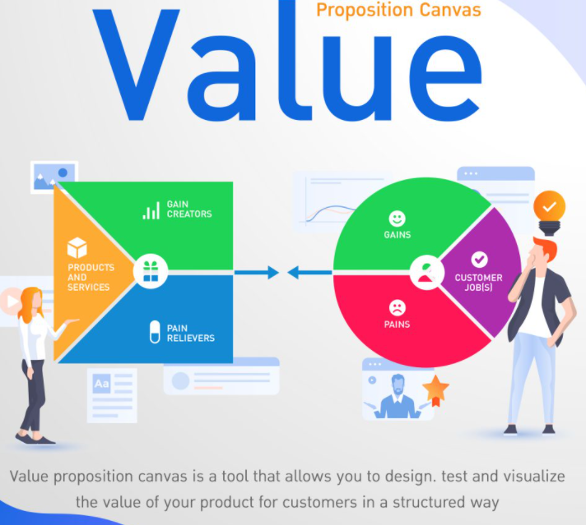
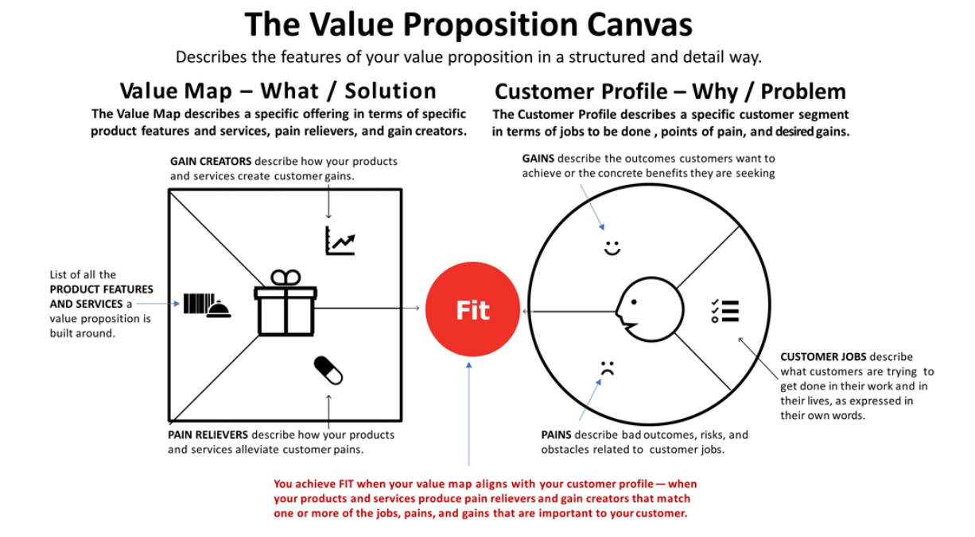
Value Proposition

Slide 2

My job = Online Learning
Gains
Save travel time and expenses.
Feeling more relaxing than in-class learning.
Can order food delivery and eat nice food and coffee during online learning.
Can review content from video record.
Jobs
Online learning.
Looking for new product or services to improve gains and alleviate pains.
Contexts
Change tools from laptop to iPad with Apple pencil.
Upgrade internet speed or change internet services provider.
The internet service provider such as AIS, True should be a partner with food delivery provider such as Grab, Lineman or Food Panda to launch discount promotion for the customer group who is using their high-speed internet.
Pains
Sometimes the laptop with mouse and key board does not work if I need to write down answer in exam.
Sometimes the internet connection is dropped and disconnected during class.
Less convenient to work with colleagues if there is a group assignment.
Sometimes I need to refresh my brain by changing learning place from home to new environment.
Loss too much money for ordering food delivery.

